Slide 1
Genetics Algorithms
Dr. Mostafa Salama
TA. Mohamed AbdelAziz
TA. Youssef Negm
TA. Assem Hafez

Slide 2
What is Genetic Algorithm?
Uses concepts from Evolutionary Biology
Initial generation is tested against the objective function
Subsequent generation evolve from the 1st generation through Selection, Crossover & Mutation
Provide efficient, effective techniques for optimization and machine learning applications
Widely-used today in business, scientific and engineering circles

Slide 3
Selection
Selection means to extract a subset of genes from an existing (in the first step, from the initial -) population, according to any definition of quality. In fact, every gene must have a meaning, so one can derive any kind of a quality measurement from it - a "value".
Selection can be performed e.g. by Selection proportional to fitness:
Consider the population being rated, that means: each gene has a related fitness. (How to obtain this fitness will be explained in the Application-section. ) The higher the value of the fitness, the better.
The mean-fitness of the population will be calculated.
Every individuum (=gene) will be copied as often to the new population, the better it fitness is, compared to the average fitness. E.g.: the average fitness is 5.76, the fitness of one individuum is 20.21. This individuum will be copied 3 times. All genes with a fitness at the average and below will be removed.
Following this steps, one can prove, that in many cases the new population will be a little smaller, than the old one. So the new population will be filled up with randomly chosen individua from the old population to the size of the old one.

Slide 4
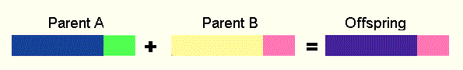
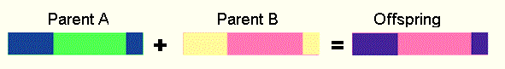
Crossover
Crossover is a genetic operator used to vary the programming of a chromosome or chromosomes from one generation to the next.
Single point crossover - one crossover point is selected, binary string from beginning of chromosome to the crossover point is copied from one parent, the rest is copied from the second parent
Two point crossover - two crossover point are selected, binary string from beginning of chromosome to the first crossover point is copied from one parent, the part from the first to the second crossover point is copied from the second parent and the rest is copied from the first parent

Slide 5
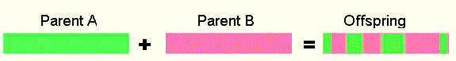
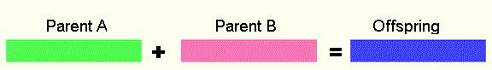
Crossover (Cont.)
Uniform crossover - bits are randomly copied from the first or from the second parent (11001011 + 11011101 = 11011111)
Arithmetic crossover - some arithmetic operation is performed to make a new offspring (11001011 + 11011111 = 11001001 (AND))

Slide 6
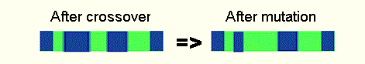
Mutation
Mutation is a genetic operator used to maintain genetic diversity from one generation of a population of genetic algorithm chromosomes to the next.
Bit inversion - selected bits are inverted

Slide 7
Simple Genetic Algorithm
{
initialize population;
evaluate population;
while TerminationCriteriaNotSatisfied
{
select parents for reproduction;
perform recombination and mutation;
evaluate population;
}
}

Slide 8
A Simple Example
The Traveling Salesman Problem:
Find a tour of a given set of cities so that
each city is visited only once
the total distance traveled is minimized

Slide 9
Representation
Representation is an ordered list of city
numbers known as an order-based GA.
1) London 3) Dunedin 5) Beijing 7) Tokyo
2) Venice 4) Singapore 6) Phoenix 8) Cairo
CityList1 (3 5 7 2 1 6 4 8)
CityList2 (2 5 7 6 8 1 3 4)

Slide 10
Crossover
Crossover combines inversion and
recombination:
* *
Parent1 (3 5 7 2 1 6 4 8)
Parent2 (2 5 7 6 8 1 3 4)
Child (5 8 7 2 1 6 3 4)
This operator is called the Order1 crossover.

Slide 11
TSP Example: 30 Cities

Slide 12
Solution _{i} (Distance = 941)

Slide 13
Solution _{k}(Distance = 652)

Slide 14
Solution _{k}(Distance = 652)

Slide 15
Best Solution (Distance = 420)

Slide 16
Overview of Performance

Slide 17
Benefits of Genetic Algorithms
Modular, separate from application
Always an answer; answer gets better with time
Easy to exploit previous or alternate solutions
Many ways to speed up and improve a GA-based application as knowledge about problem domain is gained

Slide 18
Issues for GA Practitioners
Termination Criteria
Performance, scalability
Solution is only as good as the evaluation function (often hardest part)

Slide 19
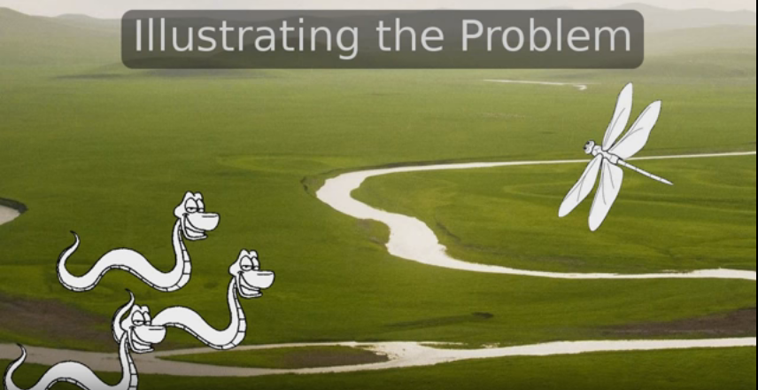
A Simple Problem
Help Snakes eat poisonous dragonflies by becoming resistant to poison, growing wings to fly and having feathers to achieve lift

Slide 20
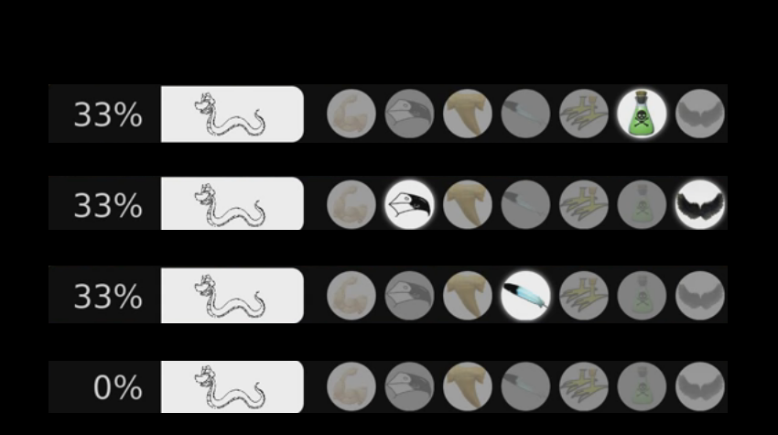
Initial Population

Slide 21
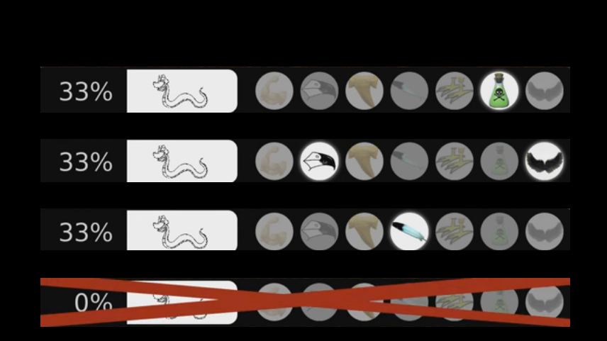
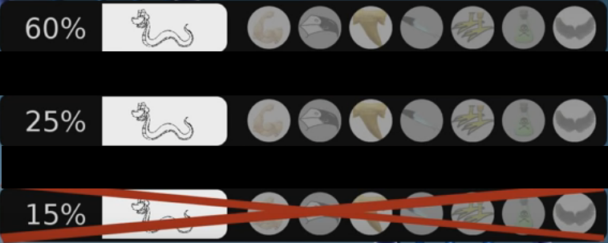
Selection

Slide 22
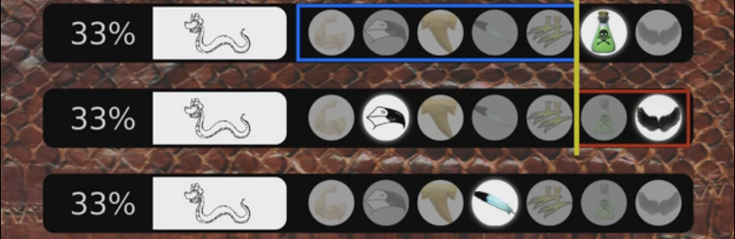
Crossover

Slide 23
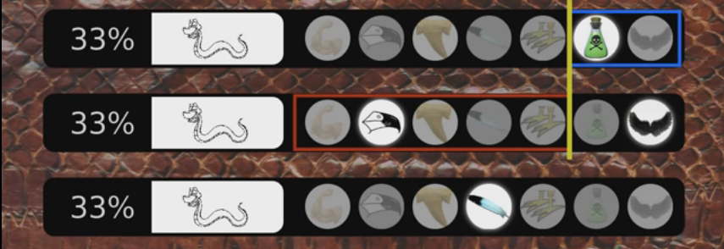
Crossover

Slide 24
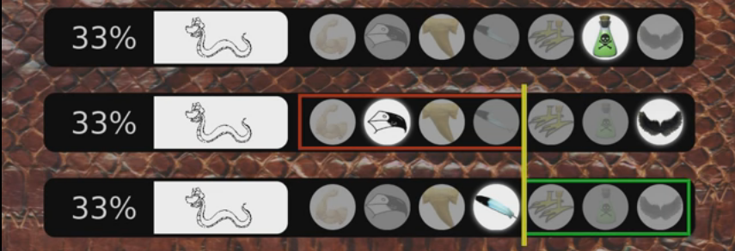
Crossover

Slide 25
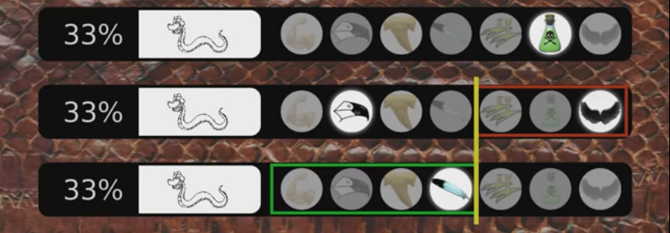
Crossover

Slide 26
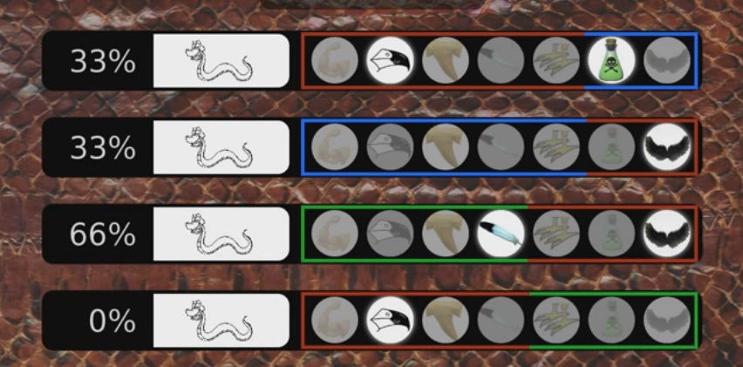
Crossover

Slide 27
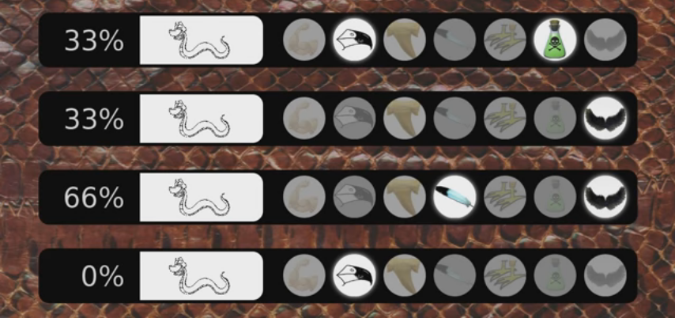
Initial Population

Slide 28
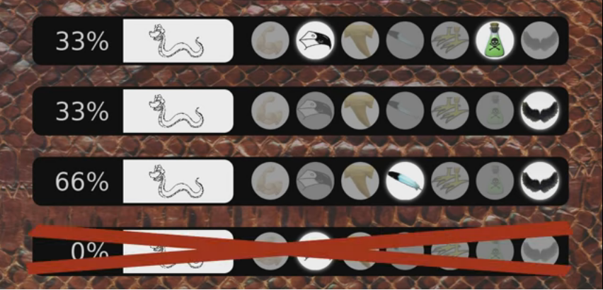
Selection

Slide 29
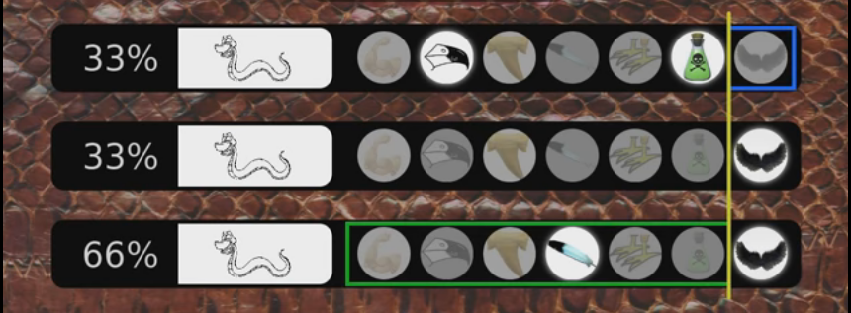
Crossover

Slide 30
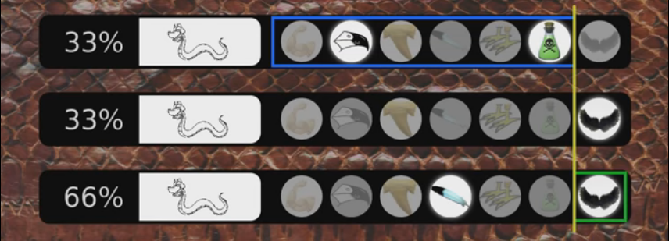
Crossover

Slide 31
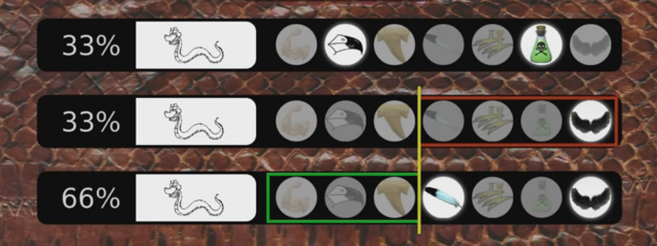
Crossover

Slide 32
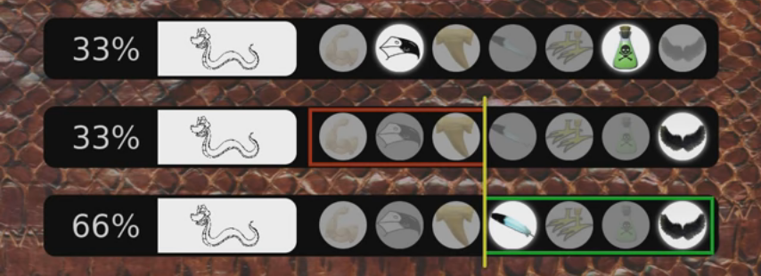
Crossover

Slide 33
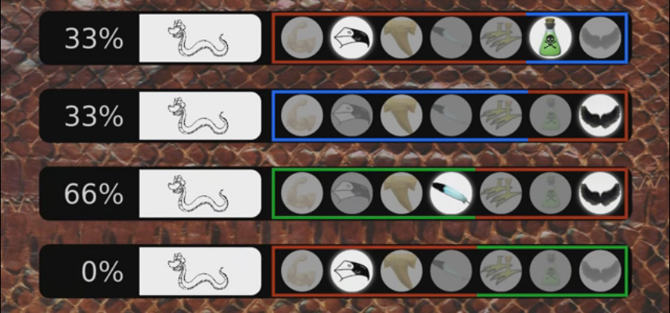
Crossover

Slide 34
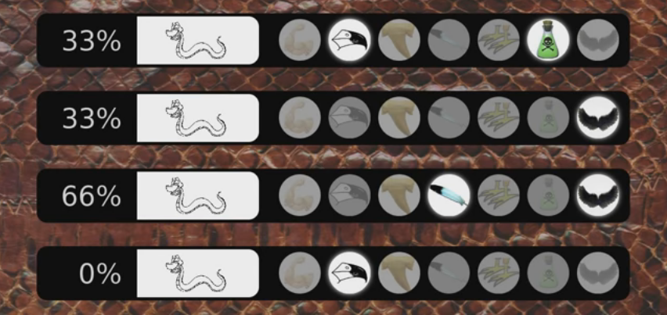
Initial Population

Slide 35
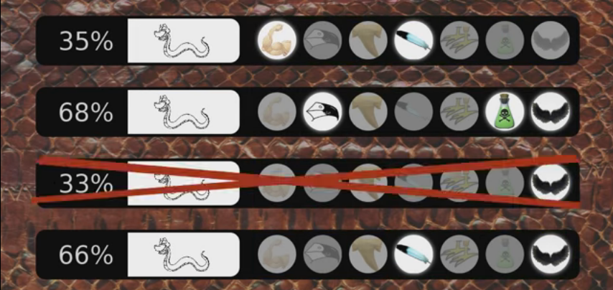
Selection

Slide 36
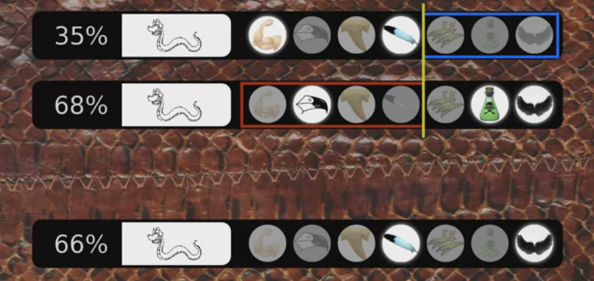
Crossover

Slide 37
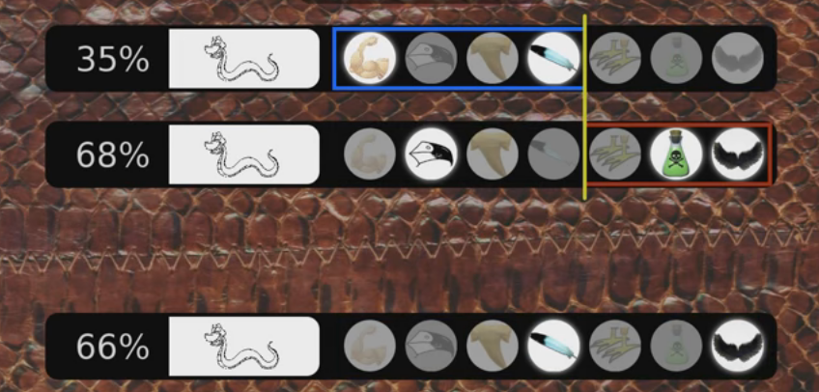
Crossover

Slide 38
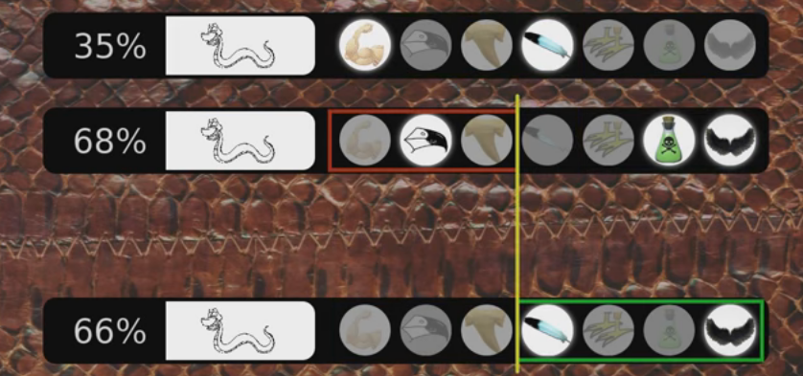
Crossover

Slide 39
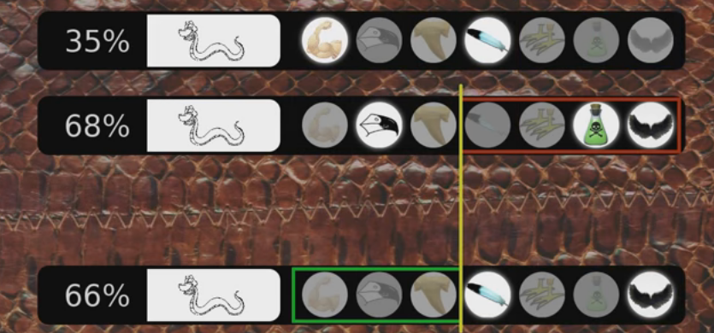
Crossover

Slide 40
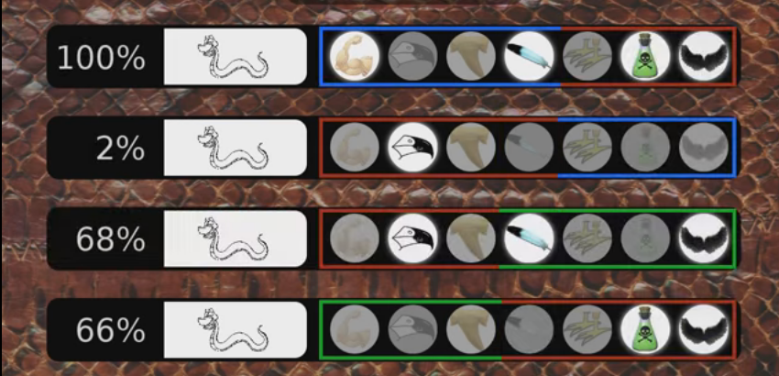
Crossover

Slide 41
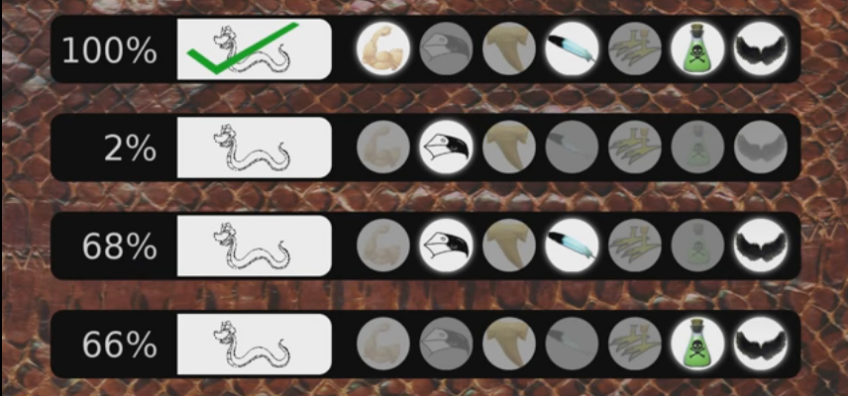
Crossover

